Slide 1

Towers of Hanoi
Justin Kim
SMU Lacey/Cebula Hall/101

Slide 2
Towers of Hanoi
There are three towers
N disks, with decreasing sizes, placed on the first tower
You need to move all of the disks from the first tower to the last tower
You can move only one disk at a time
Larger disks can not be placed on top of smaller disks
The Second tower can be used to temporarily hold disks

Slide 3
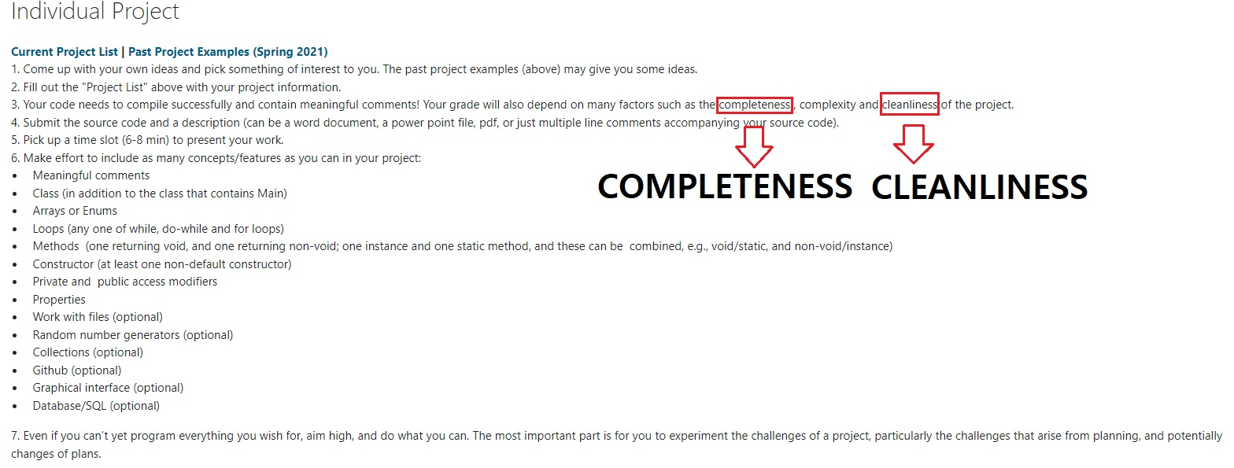

Slide 4
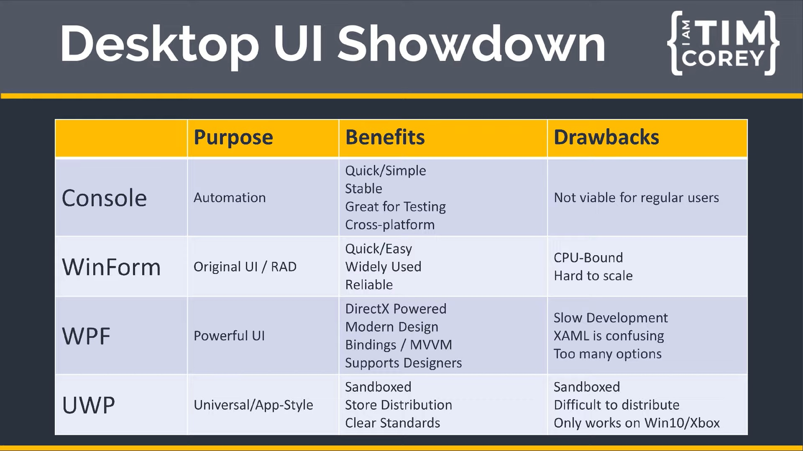
Console VS WinForm

Slide 5
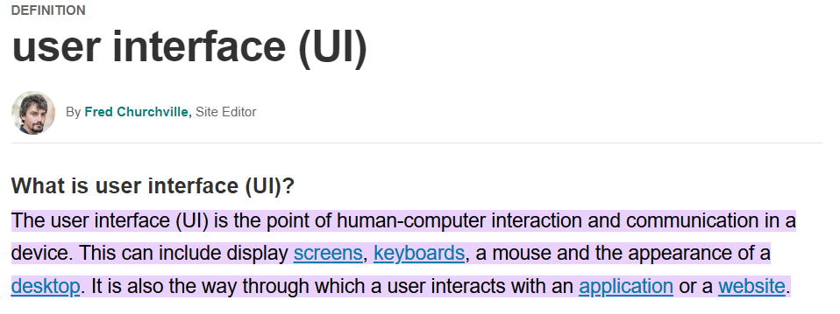

Slide 6
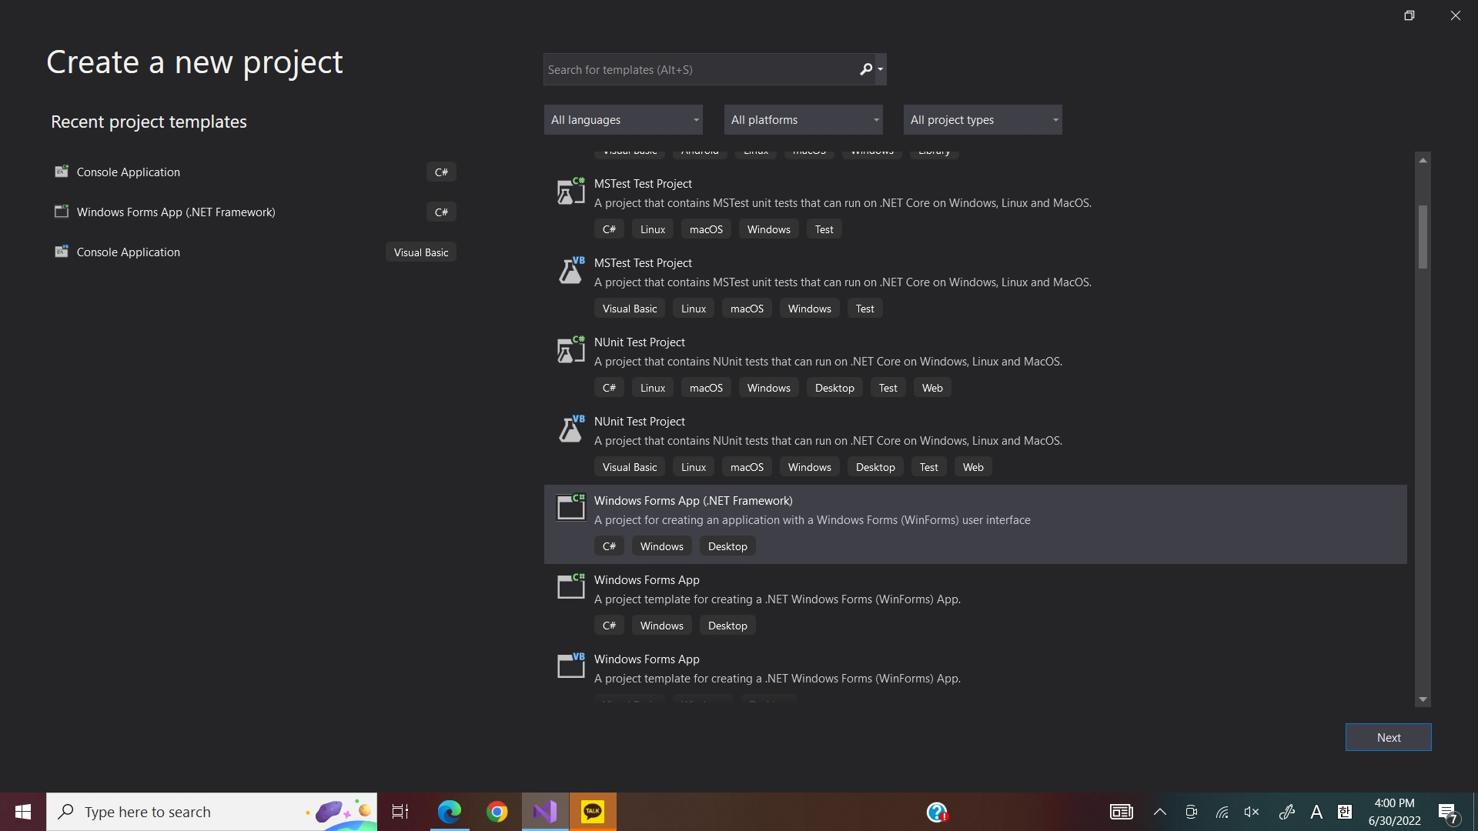

Slide 7
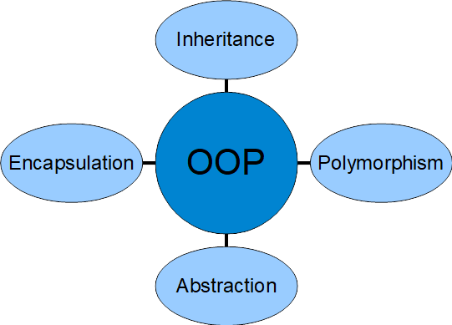
Principles of OOP
Object-oriented programming

Slide 8
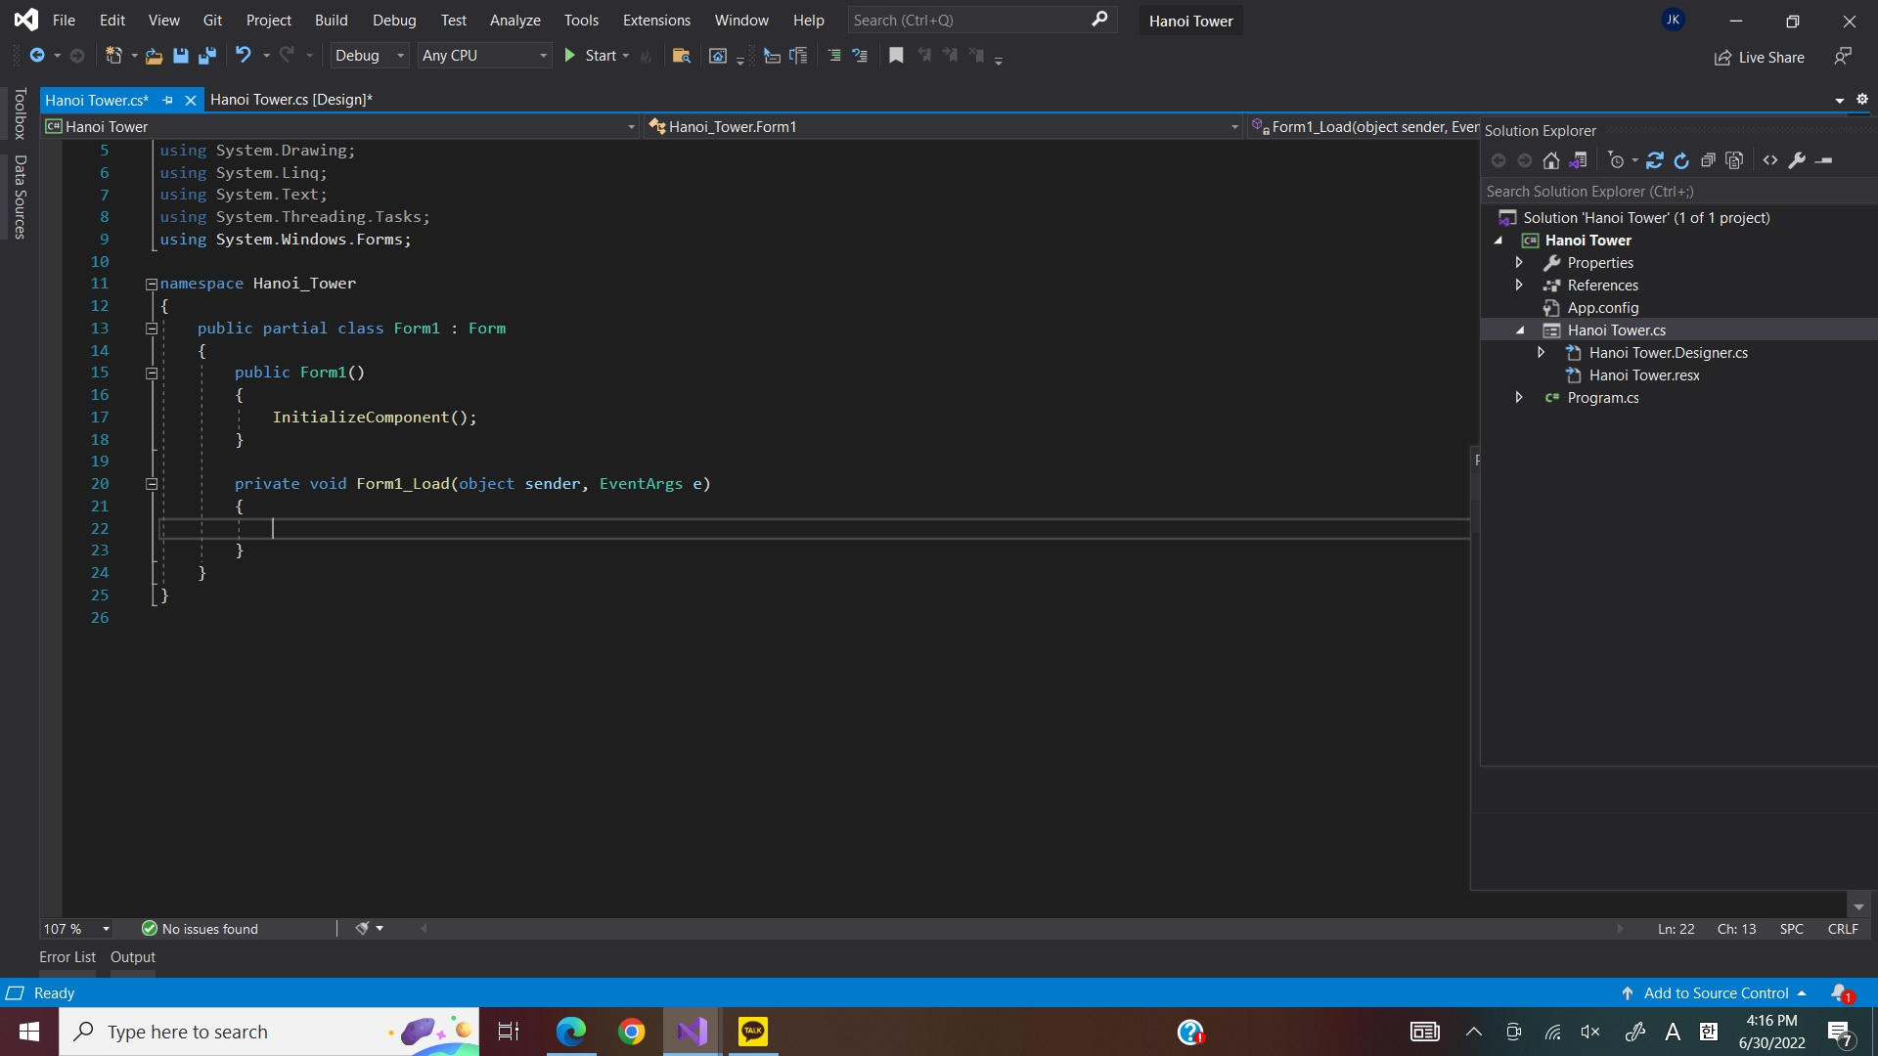
Inheritance is one of the core concepts/features of object-oriented programming (OOP)
It allows you to define a child class that reuses (inherits), extends, or modifies the behavior of a parent class
The class whose members are inherited is called the base class (parent class)
The class that inherits the members of the base class is called the derived class (child class)

Slide 9
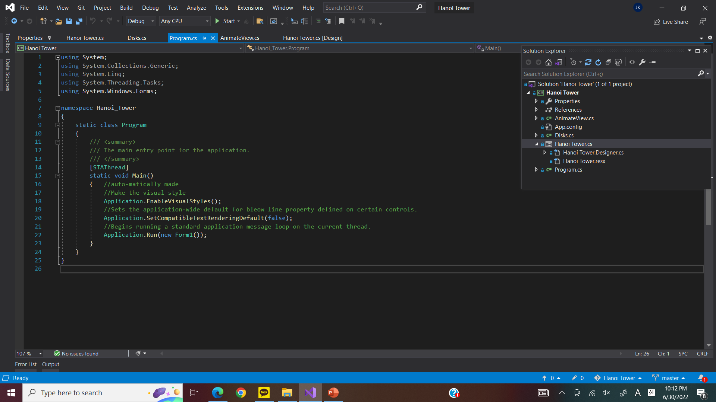

Slide 11
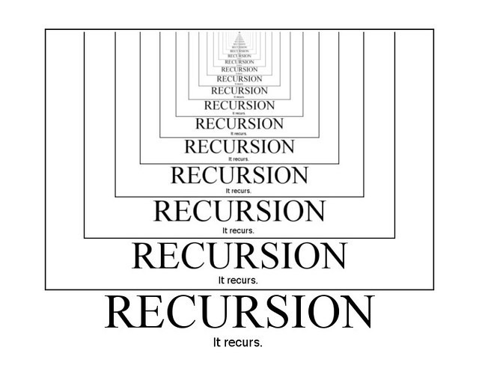
Recursion

Slide 12
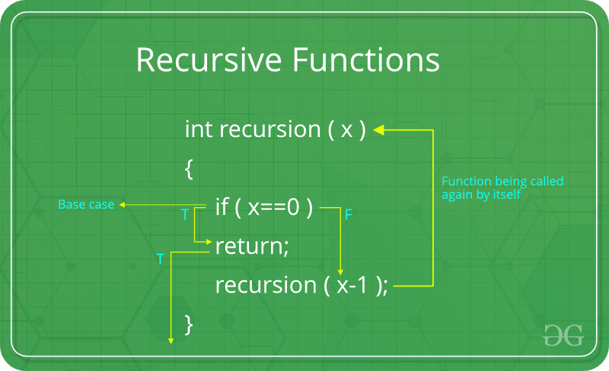
Recursive Functions

Slide 13
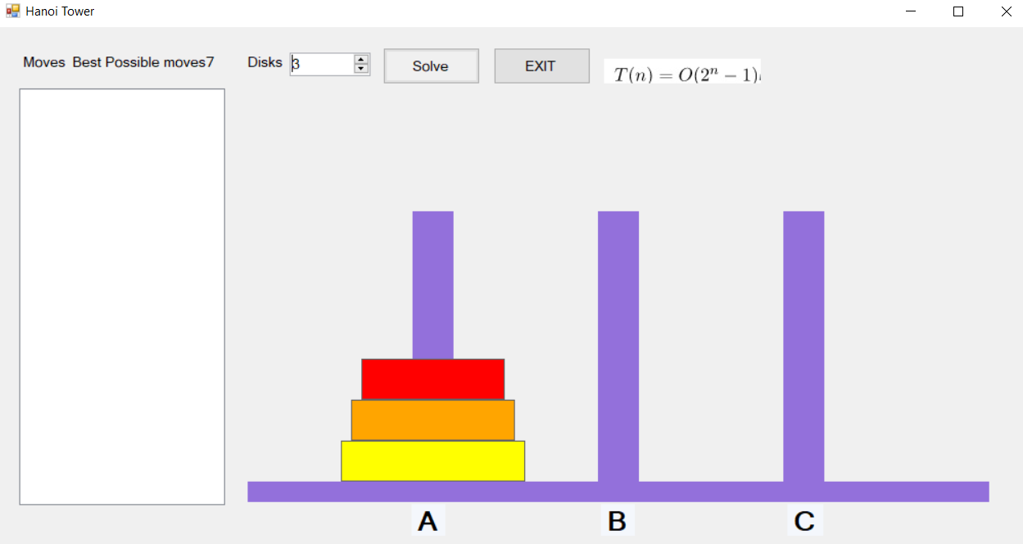

Slide 14
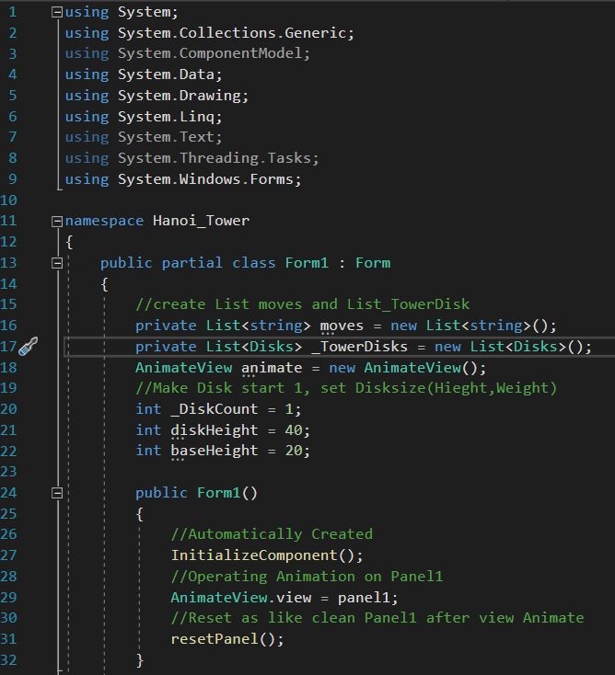

Slide 15
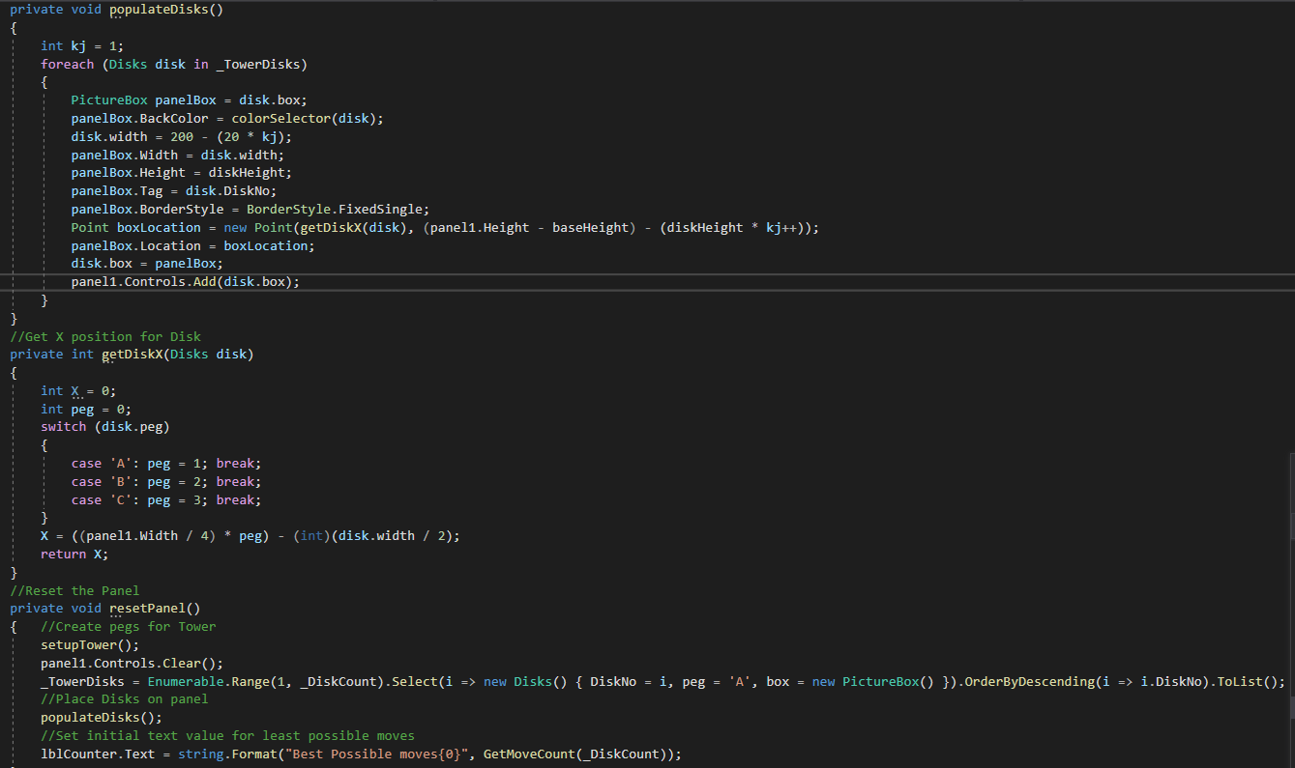

Slide 16
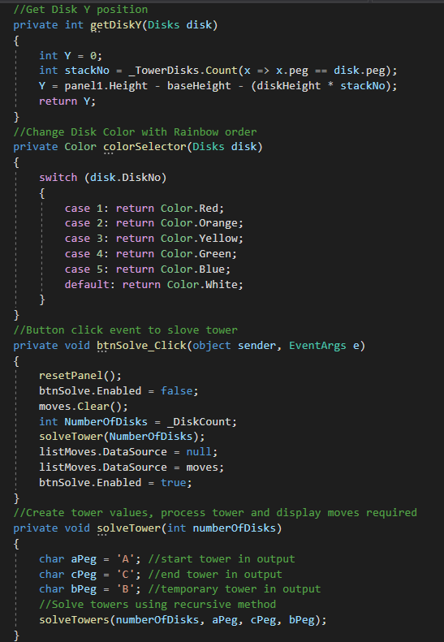

Slide 17
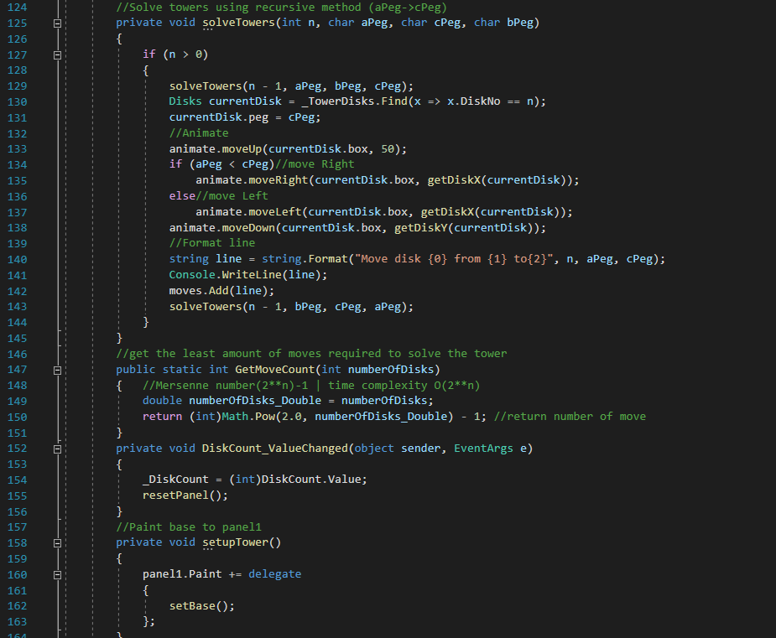

Slide 18
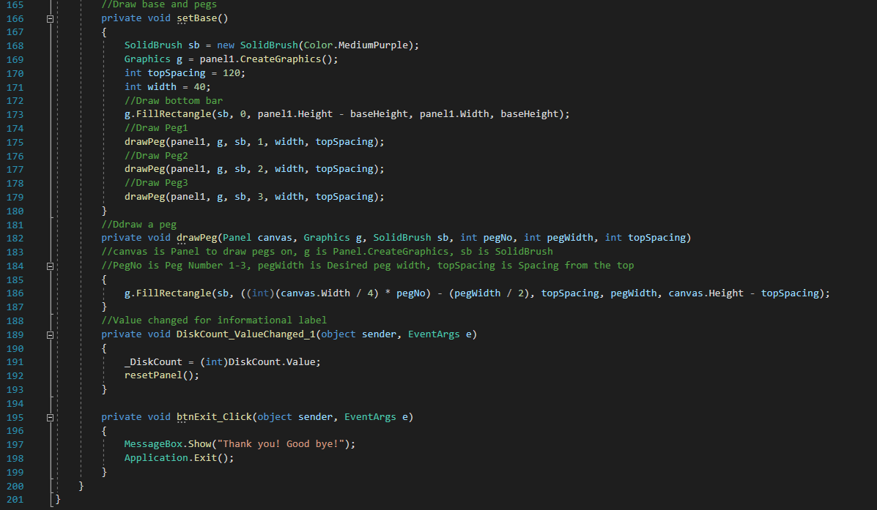

Slide 19
Source
http://www.csharpstudy.com/WinForm
https://www.guru99.com/c-sharp-windows-forms-application.html
https://docs.microsoft.com/en-us/dotnet/api/microsoft.office.interop.word.selection.movedown?view=word-pia
https://www.w3schools.com/cs/cs_properties.php
https://www.geeksforgeeks.org/recursive-functions/
CSC205 PPT files
https://stackoverflow.com/questions/35298789/solving-towers-of-hanoi-in-c-sharp-using-recursion

Slide 20
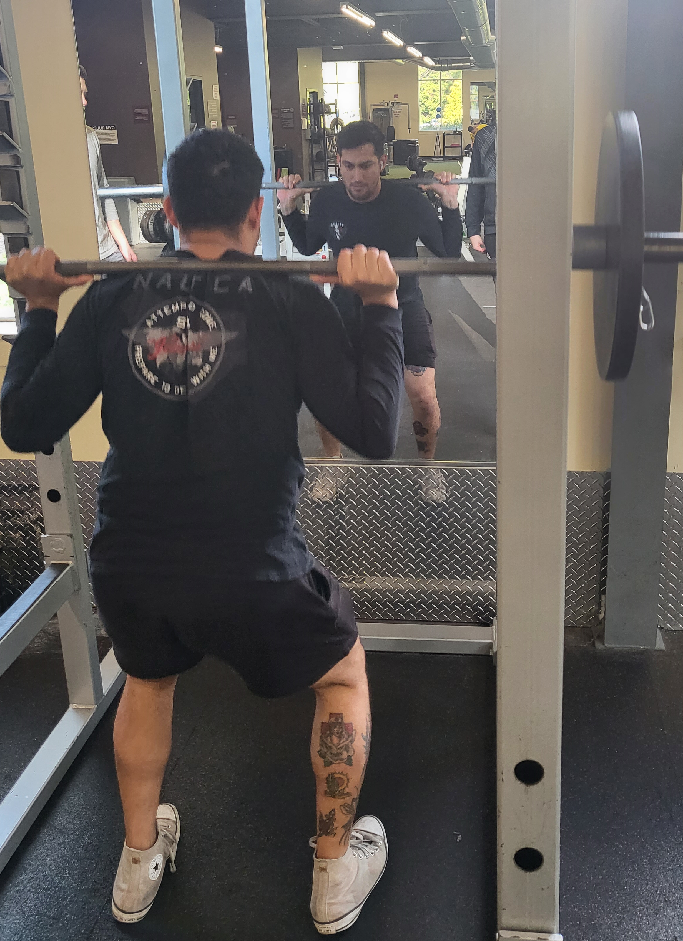
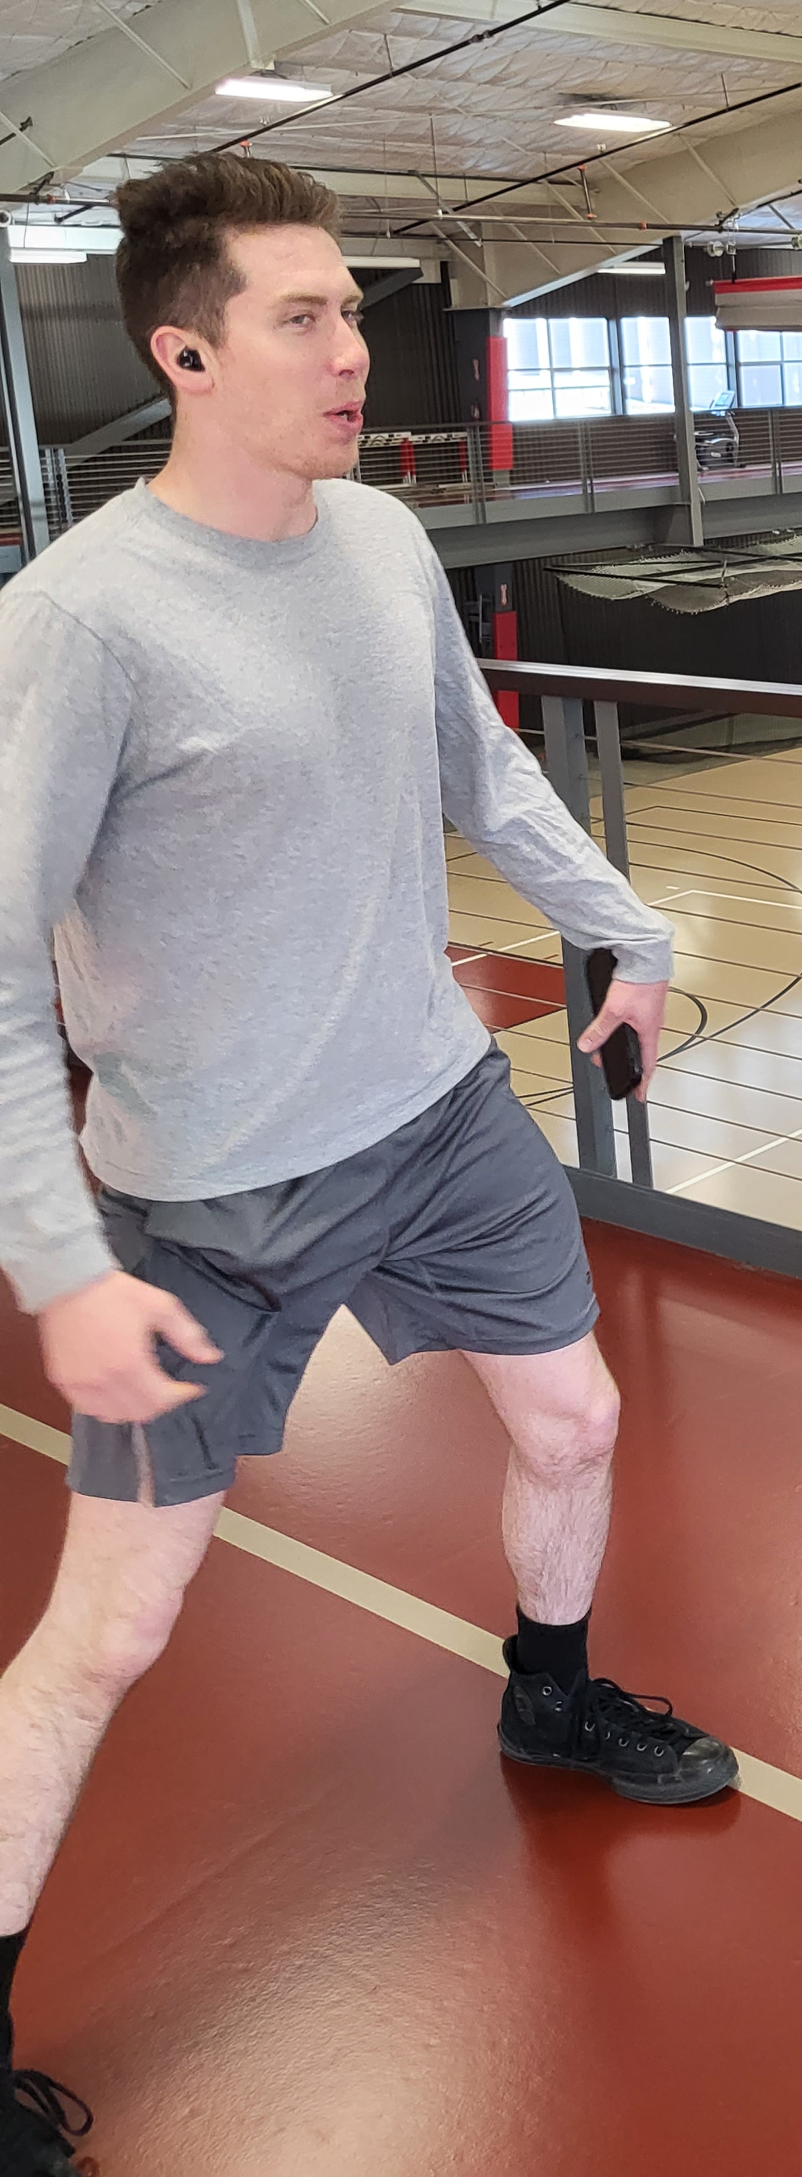


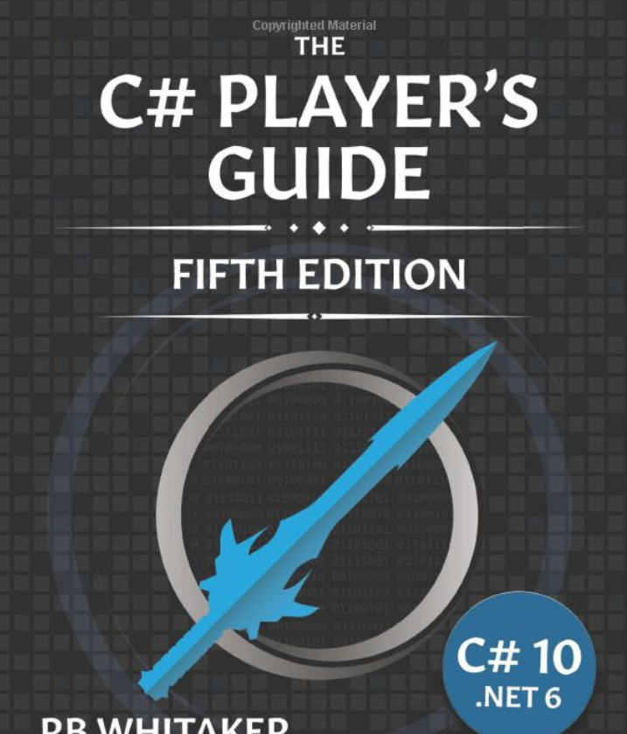
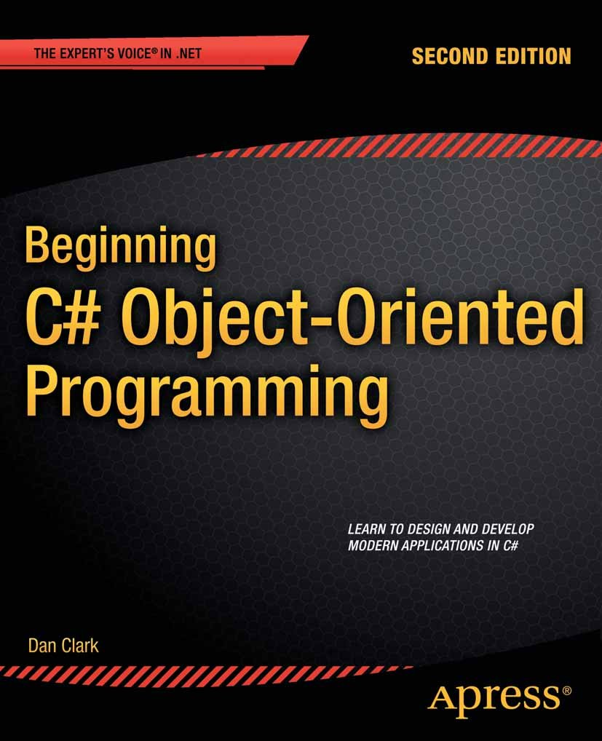


Thanks for
Dr. Li

Slide 21

Silence is Golden
You should ask question on my GitHub
https://github.com/Justinkim24

